Slide 1
MPL Industry Market Dynamics

Slide 2
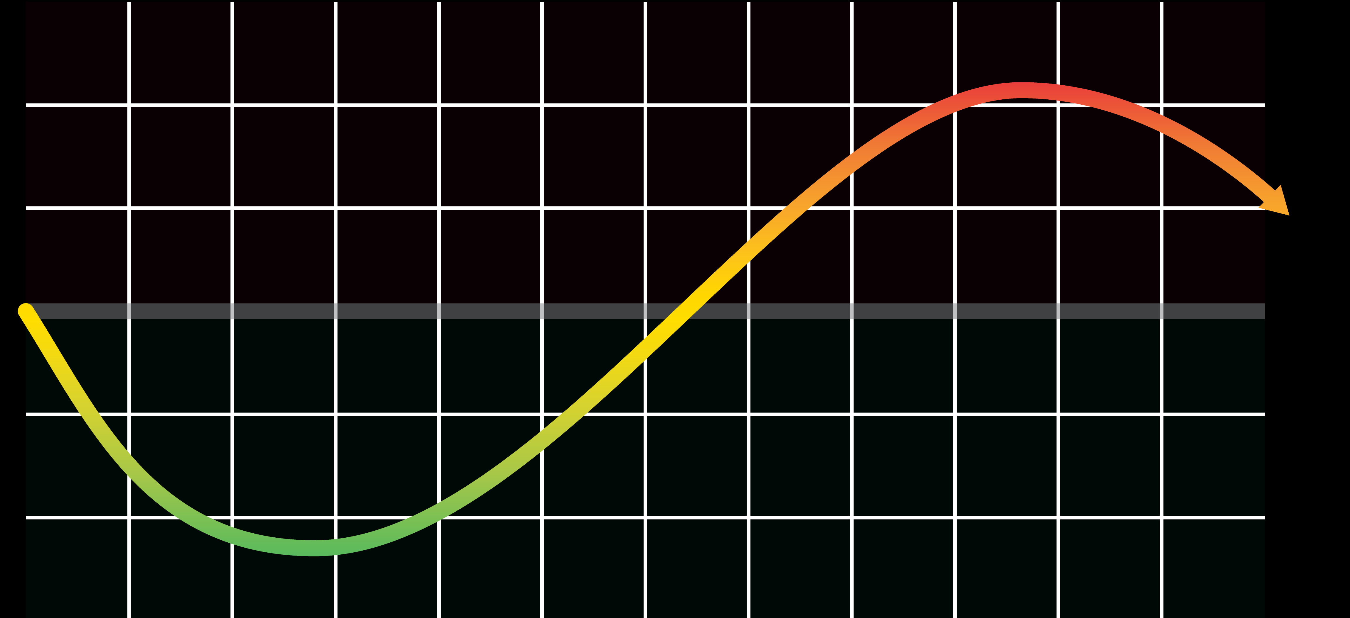

The MPL Market is Cyclical
HARD MARKET
Carriers Tend to Compete on Value
DOI Actions Increase
Losses Stabilize
Mergers & Acquisitions Increase
Commercial Carriers Exit
Underwriting Terms Loosen
Fewer Coverage Options
New Carriers Enter Market
Market Conditions Change
Underpricing Creates Vulnerabilities
Carriers Tend to Compete on Price
SOFT MARKET
2
©2023 ProAssurance Corporation • All rights reserved.
Notes:
Insurance carriers must consider the claims environment and financial conditions when determining coverage options and pricing. Responsible underwriting is essential to ensuring carriers can meet their commitments to their policyholders.

Slide 3
Nationwide MPL Combined Ratios
AM Best, Aggregates and Averages accessed on 9/21/2022
Notes:
AM Best data shows combined ratios are rising for most carriers. When combined ratios exceed 100%, corrective actions must be taken to ensure stability.
Source: AM Best, Aggregates and Averages. Medical Malpractice Line of Business on a Net Basis. Accessed on 9/21/2022.

Slide 4
Nationwide MPL Claim Severity
Computed with Data from National Practitioner Data Bank accessed on 5/16/2023
Notes:
The National Practitioner Data Bank indicates severity is trending upwards in physician (MD/DO) claims.
Source: Computed with Data from National Practitioner Data Bank accessed on 5/16/2023 for all states and physicians (MD/DO).
Note: The court system saw a slowdown of litigation during 2020 & 2021 due to the COVID-19 virus.

Slide 5
Nationwide Med-Mal Payments Over $2 Million
National Practitioner Data Bank accessed on 5/16/2023
Notes:
According to the National Practitioner Data Bank, medical malpractice indemnity payments for physicians (MD/DO) are above historic high points on a national scale.
Source: National Practitioner Data Bank accessed on 5/16/2023 for all states and physicians (MD/DO).
Note: The court system saw a slowdown of litigation during 2020 & 2021 due to the COVID-19 virus.

Slide 6
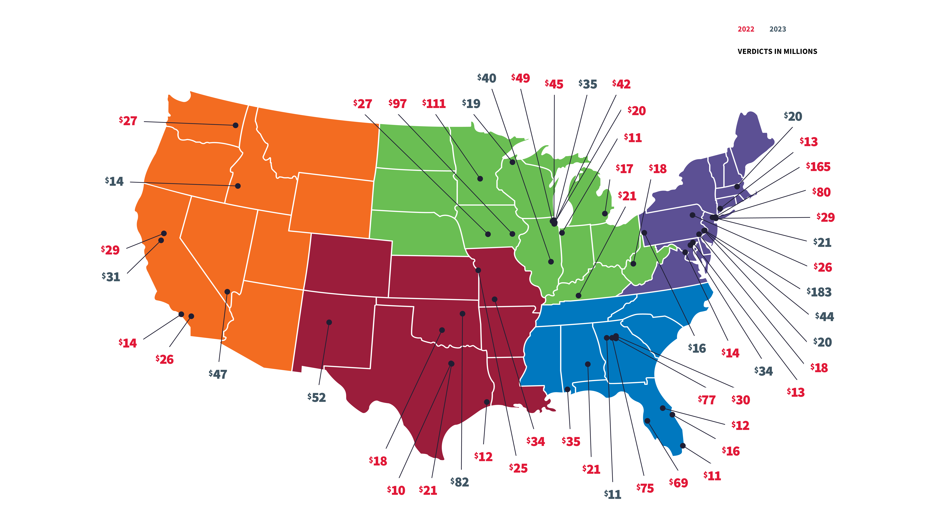
Shock Verdicts Fuel Social Inflation
2022 & 2023 Shock Verdicts
Sources: various news reports
Notes:
Claim severity has been steadily ticking up, which compounds over time. In recent years, large jury verdicts have been seen as the primary driver of increasing severity.
Due to increasing societal factors, the public’s expectations about what a jury award should be continues to rise. This is called social inflation.
Note: This slide is to be used to discuss social inflation, the number of very large verdicts, and similarly general topics. You may also discuss specific cases only (a) if you confirm they are not ProAssurance cases or (b) if they are ProAssurance cases and you de-identify them such that no presentation attendee would be able to identify the ProAssurance insured(s) involved. Please let us know if you need help confirming whether a case is a ProAssurance case or deidentifying the case information.
Sources
$183M: Philadelphia, PA - https://www.law.com/thelegalintelligencer/2023/04/26/jury-hits-penn-medicine-with-over-180m-record-verdict/
$165M: New York, NY - https://www.insurancejournal.com/news/east/2022/10/10/688781.htm
$111M: St. Cloud, MN - https://www.startribune.com/jury-awards-111m-to-college-student-after-care-at-st-cloud-hospital-left-leg-permanently-damaged/600174695/
$97M: Iowa City, IA - https://www.thegazette.com/crime-courts/jury-awards-nearly-98-million-to-iowa-city-parents-of-newborn-left-with-brain-injury/
$82M: Tulsa, OK - https://www.morelaw.com/verdicts/case.asp?s=OK&d=171135
$80M: New York, NY - https://www.law.com/newyorklawjournal/2022/10/24/80m-medical-malpractice-jury-award-in-long-running-case-is-limited-by-accord-between-parties/
$77M: Dekalb County, GA - https://www.law.com/dailyreportonline/2022/09/02/dekalb-jurys-77m-med-mal-verdict-appears-to-set-new-georgia-record/?slreturn=20221018090823
$75M: Roswell, GA - https://radiologybusiness.com/topics/patient-care/75m-malpractice-verdict-splits-fault-between-er-doctor-radiologist
$69M: Tampa, FL - https://blog.cvn.com/jury-awards-68.6m-in-med-mal-trial-over-womans-profound-brain-injury-following-sodium-imbalance
$52M: Albuquerque, NM - https://www.globenewswire.com/news-release/2023/01/25/2595506/0/en/Albuquerque-Jurors-Issue-52-Million-Verdict-in-Insurance-Bad-Faith-Lawsuit.html
$49M: Park Ridge, IL - https://www.chicagolawbulletin.com/cook-jury-49m-medical-malpractice-abdomen-20220321
$47M: Las Vegas, NV - https://www.reviewjournal.com/crime/courts/woman-with-locked-in-syndrome-awarded-47m-in-malpractice-suit-2726235/
$45M: Chicago, IL - https://www.evidencevideo.com/45-3m-verdict-in-veterans-brain-damage-case/
$44M: Philadelphia, PA - https://www.cnn.com/2023/02/15/sport/chris-maragos-wins-medical-malpractice-case-spt-intl/index.html
$42M: Chicago, IL - https://www.corboydemetrio.com/newsroom-news-2242
$40M: Mattoon, IL - https://pantagraph.com/news/local/40-million-awarded-in-central-illinois-malpractice-suit/article_ac81fa40-ccc1-11ed-8a55-2ffa4b15c482.html#:~:text=CHARLESTON%20—%20A%2019-year-,Sarah%20Bush%20Lincoln%20Health%20Center
$35M: Mobile, AL - https://www.prnewswire.com/news-releases/35-million-verdict-against-springhill-medical-center-for-death-after-thumb-surgery-301488027.html
$35M: Evanston, IL - https://www.beckershospitalreview.com/legal-regulatory-issues/northshore-physician-to-pay-35m-settlement-in-negligence-suit.html
$34M: Springfield, MO - https://www.ky3.com/2022/03/16/greene-county-jury-awards-34-million-malpractice-verdict-case-against-coxhealth/
$34M: Towson, MD - https://www.beckershospitalreview.com/legal-regulatory-issues/jury-delivers-34m-verdict-against-maryland-hospital.html?utm_medium=email&utm_content=newsletter
$31M: Sacramento, CA - https://www.prweb.com/releases/2023/01/prweb19140012.htm
$30M: Lawrenceville, GA - https://blog.cvn.com/30m-verdict-hits-ga-hospital-doctor-in-birth-injury-med-mal-trial
$29M: Marysville, CA - https://www.trains.com/trn/news-reviews/news-wire/jury-awards-28-6-million-to-man-who-lost-legs-when-hit-by-amtrak-train/
$29M: New York, NY - https://www.cbssports.com/nfl/news/former-giants-running-back-michael-cox-wins-over-28-million-in-medical-malpractice-case/
$27M: Polk County, IA - https://www.desmoinesregister.com/story/news/health/2022/11/22/jury-awards-iowa-man-millions-after-meningitis-misdiagnosed-flu-symptoms/69668716007/
$27M: Spokane, WA - https://www.spokesman.com/stories/2022/jul/20/jury-awards-27-million-to-the-estate-of-woman-who-/
$26M: Fontana, CA - https://www.prnewswire.com/news-releases/kaiser-arbitrator-awards-injured-child-over-25-6-million-301527651.html
$26M: Wilkes-Barre, PA - https://www.timesleader.com/news/1583280/jury-awards-26-million-after-medical-malpractice-trial
$25M: Kansas City, MO - https://www.prnewswire.com/news-releases/jury-awards-injured-baby-25-4m-in-kc-metros-largest-medical-malpractice-verdict-301519306.html
$21M: Montgomery, AL - https://www.al.com/news/2022/11/alabama-jury-awards-21-million-to-mom-who-lost-newborn-after-missed-diagnosis.html
$21M: Bowling Green, KY - https://www.bgdailynews.com/news/jury-awards-21-million-in-bg-medical-malpractice-trial/article_06f577c5-c178-5b3d-8be3-d2d9385567e3.html
$21M: Dallas, TX - https://www.dallasnews.com/news/courts/2022/10/31/jury-awards-21-million-to-man-in-vegetative-state-after-leg-surgery-at-dallas-hospital/
$21M: Essex County, NJ - https://www.law.com/njlawjournal/2023/03/31/essex-county-jury-returns-20-9m-verdict-in-med-mal-suit-over-double-amputation/
$20M: Oak Lawn, IL - https://chicago.suntimes.com/2022/6/27/23184866/advocate-christ-hospital-brain-damage-jury-award
$20M: Philadelphia, PA - https://www.law.com/thelegalintelligencer/2022/09/22/jury-returns-19-7m-to-penn-medicine-patient-largest-state-medical-malpractice-verdict-in-2022/#:~:text=A%20Philadelphia%20jury%20handed%20up,Pennsylvania%20so%20far%20in%202022
$20M: Lowell, MA - https://www.boston.com/news/the-boston-globe/2023/03/28/jury-awards-20-million-to-man-who-lost-a-leg-after-hospital-missed-blood-clot/
$19M: Bayfield County, WI - https://www.wpr.org/bayfield-county-jury-awards-nearly-19m-family-medical-malpractice-lawsuit
$18M: Norman, OK - https://medicalmalpracticelawyers.com/17-5-million-oklahoma-medical-malpractice-verdict/
$18M: West Chester, PA - https://www.dailylocal.com/2022/07/22/chester-county-woman-22-wins-18-million-jury-verdict-in-breast-cancer-malpractice-case/
$18M: Charleston, WV - https://apnews.com/article/health-stroke-lawsuits-wv-state-wire-accidents-4f4632e58f1cfb1624d441743376a9a4
$17M: Canton, MI - https://milawyersweekly.com/news/2023/02/28/michigans-million-dollar-verdicts-and-settlements-for-2022/
$16M: Melbourne, FL - https://www.medscape.com/viewarticle/979680
$16M: Beaver County, PA - https://www.law.com/thelegalintelligencer/2023/03/16/western-pa-jury-awards-couple-16m-verdict-in-med-mal-case/?slreturn=20230220131943
$14M: Los Angeles, CA - https://shernoff.com/our_news/los-angeles-jury-awards-14-42-million-including-7-5-million-in-punitive-damages-to-a-woman-who-became-addicted-to-opiates-because-of-health-nets-delays-in-referrals-to-specialists/
$14M: Bethesda, MD - https://thedailyrecord.com/2022/07/27/family-wins-14-million-medical-malpractice-verdict-over-sons-botched-surgery/
$14M: Ada County, ID - https://www.idahostatesman.com/news/business/article272586104.html
$13M: Westport, CT - https://www.nhregister.com/news/article/Stamford-Hospital-ordered-to-pay-Westport-man-s-17131326.php
$13M: Bel Air, MD - https://thedailyrecord.com/2022/08/02/jury-awards-13m-in-harford-county-malpractice-case-stemming-from-2004-birth/
$12M: Orlando, FL - https://blog.cvn.com/12.35m-verdict-after-life-care-centers-of-america-found-largely-liable-for-patients-bone-deep-pressure-sore
$12M: Beaumont, TX - https://medicalmalpracticelawyers.com/11-9-million-texas-birth-injury-medical-malpractice-verdict-reduced-to-2-19-million-due-to-texas-cap-on-damages/
$11M: Miami, FL - https://www.law.com/dailybusinessreview/2022/12/14/miami-dade-jury-returns-award-of-more-than-11-million-in-nursing-home-litigation/
$11M: Crown Point, IN - https://www.nwitimes.com/news/local/crime-and-courts/jury-awards-northlake-patient-11-million-in-malpractice-lawsuit/article_e8311fdc-57f9-551b-ac3f-2b52518fb2de.html
$11M: Cobb County, GA - https://www.shampsilk.com/blog/shamp-silk-obtains-105-million-medical-malpractice-verdict
$10M: Dallas, TX - https://blog.cvn.com/texas-jury-returns-10m-medical-malpractice-verdict-for-paralyzed-patient-beating-hospitals-450k-settlement-offer

Slide 7

Warning Signs Indicate Market Turn
Financial stress in the MPL insurance industry will affect individual carriers in different ways depending on their underwriting discipline over the previous 3-5 years. In past market cycle transitions, notable events signaling market distress included:
mergers & acquisitions
rehab
liquidate
exit
The combination of limited opportunities for organic growth and/or deteriorating financial results could trigger mergers in the MPL sector.
Companies are placed in receivership by their state Department of Insurance (DOI) for attempted rehabilitation.
Companies in receivership are liquidated by the DOI when rehabilitation or recapitalization fails.
Commercial/
non-MPL-specialty carriers exit the MPL line when it becomes unprofitable.

Slide 8
Distress Signals...
Prior to the COVID-19 pandemic, distress signals included several state departments of insurance taking actions against MPL specialist companies and large commercial multiline carriers exiting the market. The extended court closures and other societal factors may have temporarily eased the financial strain on other distressed carriers. However, since the height of the pandemic, there has been an uptick in M&A activity which is reminiscent of prior hardening markets.
exit
acquisition
exit
acquisition
liquidation
liquidation
exit
rehab
acquisition
JAN | JUL | JAN | JUL | JAN | JUL | JAN | JUL | JAN | JUL
2019
2020
2021
2022
2023
rehab
exit
exit
acquisition
acquisition
exit
acquisition
rehab
Notes:
Sources:
February 2019 – Texas DOI appoints a rehabilitator for Capson Physicians Insurance Company – https://bit.ly/3COCqA8
June 2019 – Texas DOI orders liquidation of Capson – https://bit.ly/3ROhQUr
August 2019 – Kansas DOI appoints a rehabilitator for Physicians Standard Insurance Company – https://bit.ly/3Cr18Fj
September 2019 – Multiline commercial carrier One Beacon announces it will exit the MPL line – https://bit.ly/3IyMbEG
October 2019 – Swiss Re, a multiline commercial carrier, exits the MPL line – https://bit.ly/38MfyQE
November 2019 – Kansas DOI orders liquidation of Physicians Standard Insurance Company – https://bit.ly/3CLkIx3
August 2020 – QBE, a multiline commercial carrier, exits the MPL line – https://bit.ly/31Zpswp
October 2020 – Multiline commercial carrier Zurich exits the MPL line – https://bit.ly/3mBaZyz
November 2020 – Reports show the acquisition of WVMIC by MagMutual – https://bit.ly/3SQeUrV
February 2021 – Vermont DOI appoints a rehabilitator for Emergency Physicians Insurance eXchange RRG – https://bit.ly/2OfjxQ7
May 2021 – ProAssurance finalizes acquisition of NORCAL Group – https://bit.ly/3L2keVc
December 2021 – Coverys Syndicate 1975 announces it will be placed into run-off at the end of 2022 – https://bit.ly/38Uk8AG
March 2022 – Constellation announces acquisition of Michigan Professional Insurance Exchange – https://bit.ly/3JYvBfl
January 2023 – MagMutual Insurance finalizes acquisition of MDAdvantage Insurance – https://bit.ly/3MOdMEF
September 2023 – NJ Pure exits the medical malpractice marketplace after 20 years – https://bit.ly/3FXWFvL
October 2023 – Constellation and Curi Holdings complete merger – https://bit.ly/3FcNck4
October 2023 – Integris Group to Acquire MedMal Direct Insurance Company – https://bit.ly/3Fowfms

Slide 9

$10M+ MPL Verdicts
*As of 3/31/2023
Source:
Notes:
The original slide was Legal approved on 1/9/23, and updated on 5/15/23.

Slide 10
$25M+ MPL Verdicts
*As of 3/31/2023
Source:

Slide 11
$50M+ MPL Verdicts
*As of 3/31/2023
Source:

Slide 12
$100M+ MPL Verdicts
*As of 3/31/2023
Source:

Slide 13
MPL Large Verdicts
*As of 3/31/2023
Source:
Notes:
This slide was Legal approved on 1/9/23, and updated on 5/15/23.

Slide 14
Industry Severity: After a pause due to COVID frequency is normalizing and severity is increasing
*As of 3/31/2023
Source:

Slide 15
Medical Malpractice Payment Ranges Heat Map
NPDB Payment Record Percentages by Year Processed and Payment Size
Processed Year | A: < 50,000 | B: >= $50,000 to $99,999 | C: $100,000 to $249,999 | D: $250,000 to $499,999 | E: $500,000 to $999,999 | F: $1,000,000 to $1,999,999 | G: >= 2,000,000
2000 | 37.1% | 16.5% | 22.6% | 13.2% | 8.9% | 1.3% | 0.5%
2001 | 35.5% | 16.4% | 22.7% | 13.7% | 9.5% | 1.6% | 0.6%
2002 | 34.6% | 16.2% | 22.5% | 14.6% | 9.9% | 1.7% | 0.6%
2003 | 32.7% | 16.0% | 21.8% | 16.1% | 10.8% | 1.8% | 0.7%
2004 | 30.9% | 15.8% | 23.2% | 16.3% | 11.5% | 1.7% | 0.6%
2005 | 30.4% | 16.2% | 23.8% | 16.2% | 11.1% | 1.8% | 0.6%
2006 | 30.8% | 15.7% | 22.8% | 16.2% | 11.8% | 1.9% | 0.7%
2007 | 30.4% | 14.7% | 23.2% | 16.9% | 11.6% | 2.3% | 0.8%
2008 | 29.0% | 15.6% | 23.7% | 16.9% | 11.6% | 2.4% | 0.8%
2009 | 29.5% | 15.6% | 23.6% | 16.7% | 11.0% | 2.6% | 0.9%
2010 | 30.3% | 15.1% | 23.3% | 16.9% | 11.4% | 2.5% | 0.7%
2011 | 29.7% | 15.7% | 23.7% | 16.5% | 11.1% | 2.4% | 1.0%
2012 | 29.8% | 15.5% | 22.6% | 17.0% | 11.5% | 2.7% | 0.8%
2013 | 27.7% | 15.5% | 23.9% | 17.2% | 12.2% | 2.6% | 0.8%
2014 | 28.6% | 14.3% | 23.4% | 17.6% | 12.2% | 2.9% | 0.9%
2015 | 27.2% | 14.1% | 23.6% | 18.6% | 12.3% | 2.9% | 1.2%
2016 | 28.0% | 14.3% | 22.8% | 17.6% | 13.2% | 2.8% | 1.2%
2017 | 26.8% | 14.7% | 23.0% | 18.0% | 13.5% | 2.9% | 1.1%
2018 | 24.5% | 14.4% | 23.5% | 19.2% | 13.8% | 3.4% | 1.2%
2019 | 23.9% | 14.2% | 22.9% | 19.6% | 14.6% | 3.4% | 1.5%
2020 | 24.7% | 13.9% | 23.5% | 19.1% | 13.8% | 3.5% | 1.4%
2021 | 24.8% | 13.9% | 25.0% | 18.5% | 13.5% | 3.0% | 1.3%
2022 | 21.2% | 14.9% | 24.4% | 19.9% | 14.7% | 3.4% | 1.4%
Source: National Practitioner Data Bank
Notes:
This slide was Legal approved on 1/9/23.

